Slide 1
Shedding Light on the Long Shadow of Childhood Adversity
David Brent, MD & Michael Silverstein, MD, MPH

Slide 2
Conflict of Interest Disclosures
David Brent
Guilford Press, royalties
eResearch Technology, royalties
UpToDate, Editorial Board
Honoraria, Oxford Press
Michael Silverstein
Nothing to disclose

Slide 3
Objectives
Review the strong association between childhood adversity and subsequent physical and mental disability
Describe possible etiologic pathways
Make recommendations for research, clinical care, and policy

Slide 4
Childhood Adversity: What is it?
Poverty
Abuse, neglect, and exposure to domestic violence
Parent with untreated serious psychiatric disorder
Parental criminality
Associated with nearly every cause of premature mortality, decreased productivity, and increased health care costs

Slide 5
Adverse Childhood Experiences Account for a Large Proportion of Chronic Health Conditions*
*Felitti et al., 1998

Slide 6
Health and Productivity*
*Anda et al., 2004

Slide 7
Health Care Costs and History of Abuse*
*Bonomi et al., 2007

Slide 8
Stress, the HPA Axis, and Inflammation*
*Miller et al., 2009

Slide 9
The Nature of Nurture*
*Hackman et al., 2010

Slide 10
Epigenetic changes in the GR in abused suicide victims*
*McGowan et al.,2009

Slide 11
Familial Transmission of Adversity*
*Felitti et al., 2008

Slide 12
Poverty and Child Psychopathology Before and After Casino in a Native American Community*
Child symptoms
*Costello et al., JAMA, 2003

Slide 13
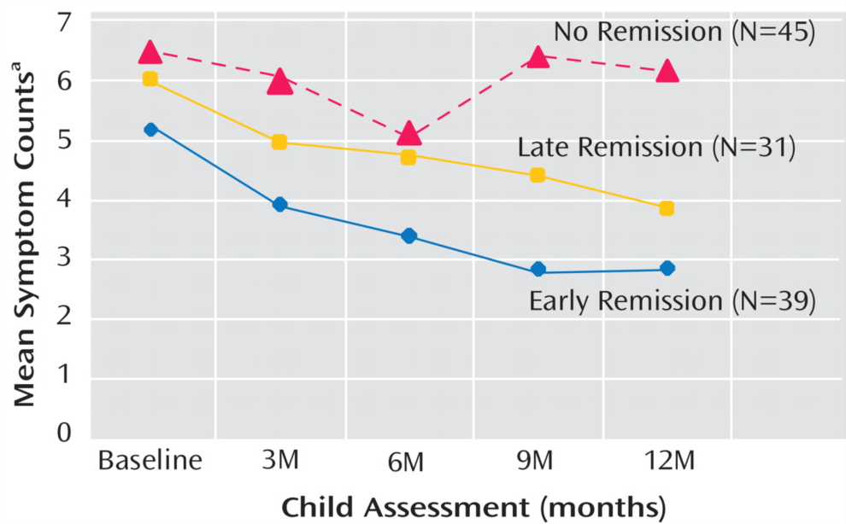
From: Children of Depressed Mothers 1 Year After the Initiation of Maternal Treatment: Findings From the STAR*D-Child Study*
*Pilowksy et al., 2008

Slide 14
Decreased Governmental Costs for Mothers Who Participated in the Nurse Family Partnership Intervention*
*Olds DL et al., 2010

Slide 15
Implications
Research– mechanisms, how to prevent or attenuate, alternative approaches to treatments for those with history of ACE
Clinical care– assess, intervene in those variables that are malleable, engage, collaborative care
Policy– advocate for social policies and programs that can help families overcome adversity
Recognize that ACE exacts a severe cost on society– one we can invest in grappling with now-or cost we will all eventually bear in lower productivity, and greater health care costs

Slide 16
New Zealand Toast
To the cause that needs assistance
To the wrong that needs resistance
To the future in the distance
And the good that we can do
Mick Collins

