Slide 1
HIV/AIDS
JAMA Theme Issue Media Briefing
2012 International AIDS Conference
Sunday, July 22, 2012

Slide 2
HIV in Persons Born Outside the
United States, 2007-2010
Prosser AT, Tang T, Hall HI.
H Irene Hall, PhD, FACE
July 22, 2012
National Center for HIV/AIDS, Viral Hepatitis, STD, and TB Prevention
Division of HIV/AIDS Prevention

Slide 3
Persons Born Outside the United States
Background
According to the U.S. Census:
  40 million (13%) of the nation's population born outside the U.S.
  33 million (11%) native-born with at least one foreign-born parent
  One in five people either a first or second generation American
  Persons born outside the U.S. are an integral part of our society
Due to language and policy barriers, persons born outside the U.S. are less likely to have health insurance and access health care

Slide 4
Major Findings
Persons born outside the U.S. diagnosed with HIV represented 16% of all persons diagnosed with HIV in the U.S., slightly higher than the 13% of persons born outside the U.S. living in the U.S. general population
Compared to persons born in the U.S., higher percentages of persons diagnosed with HIV born outside the U.S.—
  Were Hispanic/Latino or Asian
  Had infection attributed to heterosexual contact

Slide 5
Objective
Describe epidemiology of HIV infection among persons born outside the United States

Slide 6
Data Source
National HIV Surveillance System
  CDC collects information on HIV diagnoses in collaboration with state and local health departments
  Names or other personally identifiable data are not sent to CDC
  Information is collected on country of birth but not on immigration status or date of entry to the United States
  Unknown whether infection preceded or followed immigration
Analyses included persons diagnosed 2007 - 2010 in 46 states and 5 U.S. dependent areas

Slide 7
Diagnoses of HIV Infection among Persons Born Outside the United States
Estimated total number of diagnoses, 191,697
Of these, 30,995 (16%) among persons born outside the U.S.
  The percentage is slightly higher than the percentage of persons born outside the United States (13%) currently living in the U.S.
74% of persons diagnosed with HIV born outside the U.S. were male (vs. 78% among U.S.-born)

Slide 8
Diagnoses of HIV Infection, by Race/ethnicity
 |  | Born outside the U.S.
 | Total | Number | %
American Indian/Alaska Native | 862 | 53 | 6
Asian | 3,088 | 1,987 | 64
Black/African American | 86,547 | 8,614 | 10
Hispanic/Latino | 42,431 | 17,913 | 42
Native Hawaiian/Other Pacific Islander | 278 | 89 | 32
White | 55,574 | 1,841 | 3

Slide 9
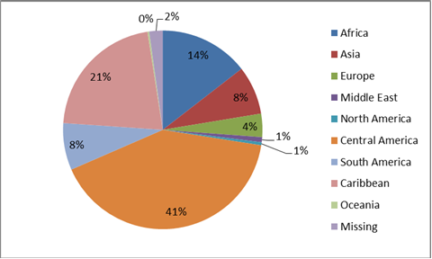
Diagnoses of HIV Infection among Persons Born Outside the United States, by World Region of Origin
World Region | Total
Africa | 3,656
Asia | 1,995
Europe | 958
Middle East | 208
North America | 126
Central America | 10,343
South America | 1,929
Caribbean | 5,418
Oceania | 69
Unknown | 551
Total | 25,255

Slide 10
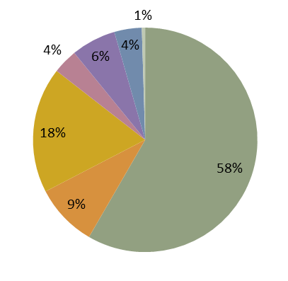
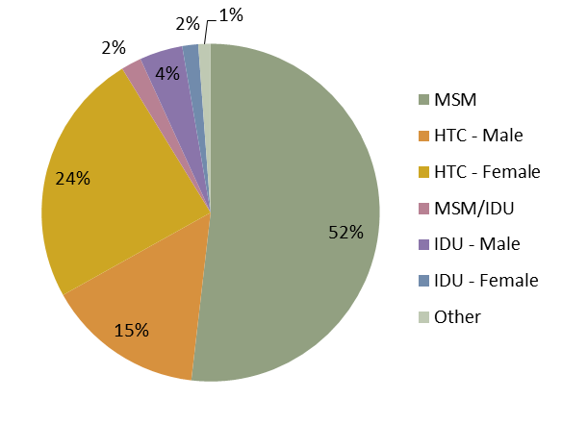
Diagnoses of HIV Infection among Persons born in and Outside the United States, by Transmission Category
Born in the United States
n=160,702
Born Outside the United States
n=30,995
HTC=Heterosexual contact; Other includes adult other, child other, and perinatal

Slide 11
Diagnoses of HIV Infection among Persons Born Outside the United States, by Region of Origin and Transmission Category
 |  | Transmission Category
World Region | Total | Hetero-sexual contact % | Male-to-male sexual contact %
Africa | 3,656 | 74 | 16
Asia | 1,995 | 29 | 64
Europe | 958 | 22 | 65
Middle East | 208 | 19 | 72
North America | 126 | 18 | 74
Central America | 10,343 | 28 | 64
South America | 1,929 | 25 | 70
Caribbean | 5,418 | 60 | 33
Oceania | 69 | 22 | 68
Unknown | 551 | 50 | 39
Total | 25,255

Slide 12
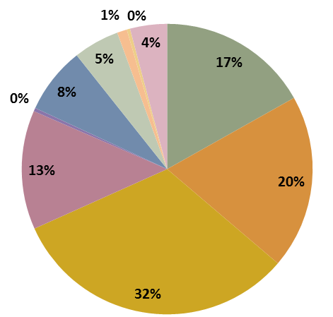
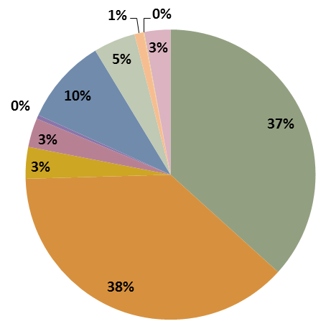
HIV Diagnoses in Foreign Born Persons in the United States: World Region of Origin and U.S. Residence at Diagnosis, 46 States, 2007-2010

Slide 13
Summary
Persons born outside the U.S. diagnosed with HIV represented 16% of all persons diagnosed with HIV in the U.S., slightly higher than the 13% of persons born outside the U.S. living in the U.S. general population
Compared to persons born in the U.S., higher percentages of persons diagnosed with HIV born outside the U.S.—
  Were Hispanic/Latino or Asian
  Had infection attributed to heterosexual contact

Slide 14
Discussion
Persons born outside the United States may face challenges in accessing health care and health information
Lifting of the HIV Immigration Exclusion in January 2010 may cause changes in the future epidemiology of HIV in persons born outside the U.S.
  HIV not included in immigration screening tests required for entry to the United States
HIV testing needed to identify persons in need of care

Slide 15
Questions?
For more information please contact Centers for Disease Control and Prevention
1600 Clifton Road NE, Atlanta, GA 30333
Telephone: 1-800-CDC-INFO (232-4636)/TTY: 1-888-232-6348
E-mail: cdcinfo@cdc.gov Web: http://www.cdc.gov
The findings and conclusions in this report are those of the authors and do not necessarily represent the official position of the Centers for Disease Control and Prevention.
National Center for HIV/AIDS, Viral Hepatitis, STD, and TB Prevention
Division of HIV/AIDS Prevention

Slide 16
HIV/AIDS
JAMA Theme Issue Media Briefing
2012 International AIDS Conference
Sunday, July 22, 2012

Slide 17

Risk of Cervical Precancer/Cancer in HIV+ Women with a Normal Pap and Negative Oncogenic HPV Test
Marla Keller, MD and Howard D. Strickler, MD, MPH
Albert Einstein College of Medicine
Montefiore Medical Center
For the Women’s Interagency HIV Study (WIHS)

Slide 18
Overview
Similar low 5-year risk of cervical pre-cancer/cancer in HIV(+) and HIV(-) women who had a normal Pap and negative HPV test at enrollment.
Thus, similar to guidelines in HIV(-) women, HPV co-testing might be useful in reducing the burden of frequent cervical cancer screening in HIV(+) women.

Slide 19
Cervical cancer is the 3rd most common cancer in women worldwide.
In HIV(+) women:
  Cervical cancer risk is increased several-fold, and it is considered an AIDS-defining malignancy.
  Human papillomavirus (HPV), the viral cause of cervical cancer, is increased several-fold.
Notes:
To put this study in perspective it is important to remind everyone that cervical cancer is the 3rd………

Slide 20
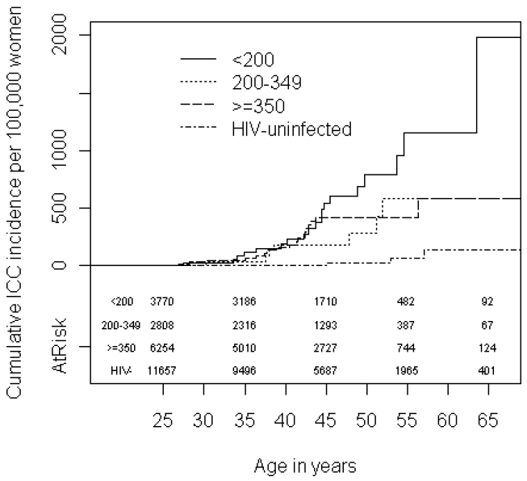
Cervical Cancer Risk Increases with Immunosuppression in HIV+ Women
Abraham and D’Souza et al (for NA-ACCORD)

Slide 21
Cervical Cancer Screening Guidelines:
HIV+ Women
Pap tests should be obtained twice in the first year after diagnosis of HIV and, if normal, annually thereafter.
Borderline neoplasia or worse (ASC-US+) by Pap test should be referred to colposcopy and, if indicated, biopsy.
HPV DNA testing is not recommended.

Slide 22
Burden of Repeated Pap Tests in HIV+ Women
25%-35% of HIV+ women have ASC-US+ at each clinical visit and are referred for colposcopy.
Among HIV+ ASC-US+ 25% have precancer / cancer.
USPHS: colposcopy/biopsy in response to false-positive screening tests are “harms”, due to risk of bleeding, pain, infection, distress/anxiety.
Can we cut down on unnecessary screening tests?

Slide 23
Cervical Cancer Screening Guidelines:
General Population
Age Group | Screening Methods | Management of Results
< 21 years | No Screening
21-29 years | Pap tests every 3 years | HPV testing only for ASC-US
30-65 years | Pap + HPV “Co-Testing” every 5 years (preferred) | HPV+/normal Pap = screen 1 yr if HPV16 or 18 = colposcopy if other HPV = screen 1 yr
 | Pap tests every 3 years | HPV testing only for ASC-US
>65 years | No screening

Slide 24
Genetic / Epigenetic Changes
Infection
Progression
Transformation
Normal
HPV Infected
Persistent
HPV
Precancer
(CIN-2+)
Cancer
Regression
Clearance
Based on this model: a woman with a normal Pap and no oncogenic HPV should have low risk of cervical precancer / cancer for several years - - - - - regardless of HIV status.

Slide 25
Prior Study
Only one prior prospective cohort study of this topic.
Harris et al, JAMA;293:1471-6, 2005 found low 5-year risk of cervical precancer/cancer in HIV+ women with a normal Pap and negative HPV test.
The prior study lacked histology and involved specimens and data obtained prior to the widespread use of HAART.
  In the HAART era women live longer with improved, albeit, still diminished immune status, giving HPV more time to persist.

Slide 26
Women’s Interagency HIV Study (WIHS)
Largest prospective cohort of HIV+ women in US
    Representative of HIV/AIDS cases nationwide
Semi-annual clinical follow-up
Detailed questionnaires, general physical & gynecological exam, Pap test, CVL
HPV DNA Testing
  MY09/MY11 PCR for >40 HPV types

Slide 27
Baseline Characteristics | Enrolled 2001 - 2002
HIV-positive HIV-negative | N=737 N=406
Age (median) | 31 years
Race Black Hispanic White Other | 56% 30% 10% 4%
Clinical Sites Bronx/NYC Brooklyn Wash, DC Los Angeles San Francisco Chicago | N 234 214 170 226 159 141
HIV+ Subjects HAART CD4+ Median IQR | 42% 492 332, 696

Slide 28
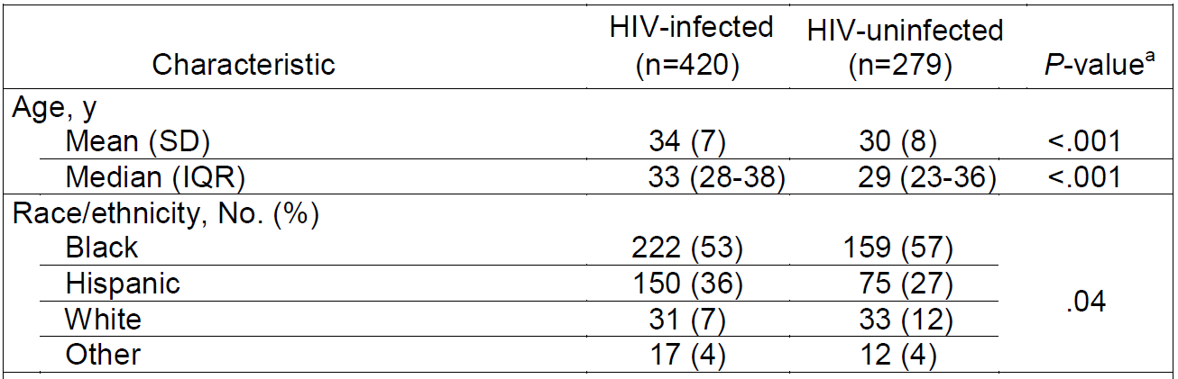
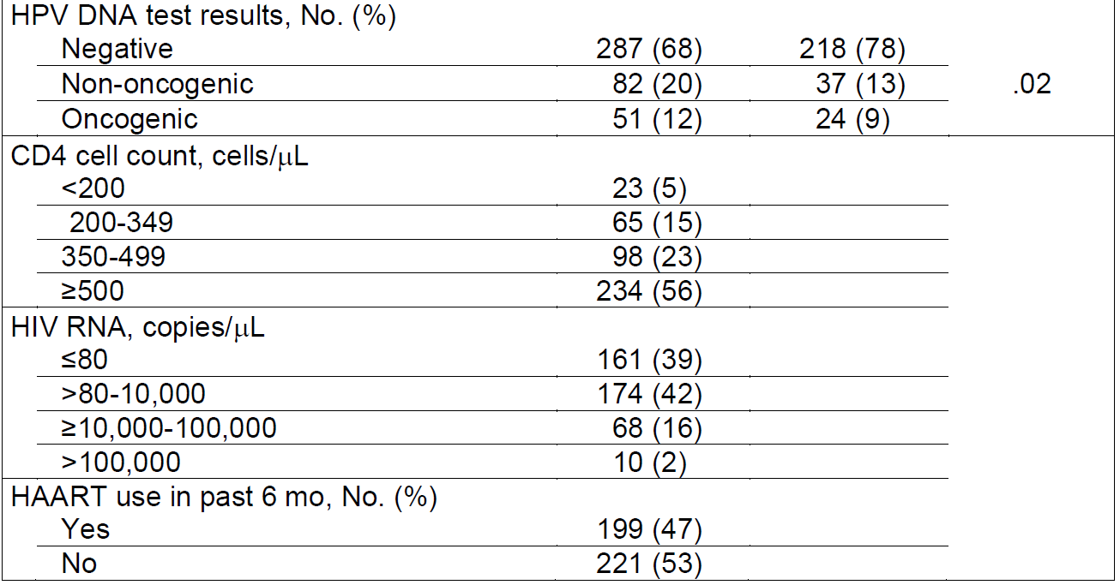
Table 1. Baseline Characteristics of WIHS Women with Normal Pap

Slide 29
Analysis
Limited to Pap normal / oncogenic HPV-negative
Standard life-table statistical methods
Follow-up at 3 years and 5 years
  Secondary analyses: follow-up at 7 years and 9 years
Endpoints:
  HSIL+ by cytology
  CIN-2+ and CIN-3+ by histology as separate endpoints

Slide 30
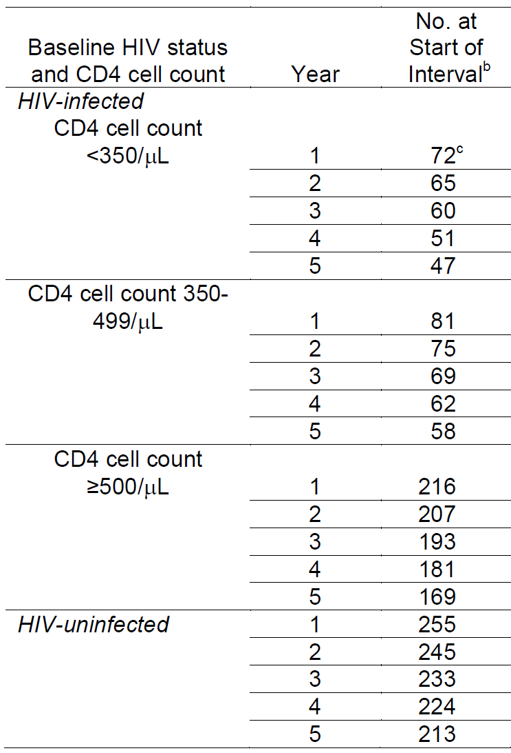
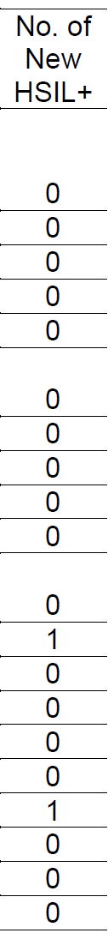
Cumulative Incidence of HSIL+

Slide 31
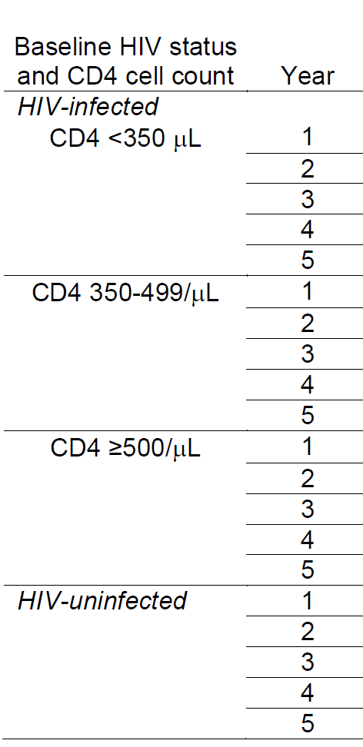
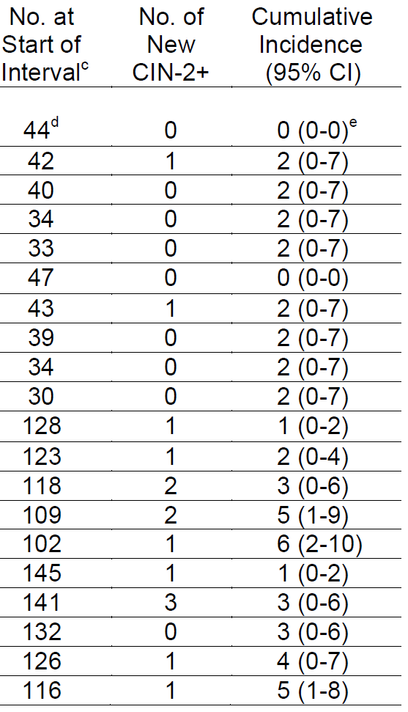
Cumulative Incidence of CIN-2+

Slide 32
5-Years of Follow-up
CIN-2+
HIV-negative = 5% (95% CI, 1%-8%)
HIV-positive = 5% (95% CI, 2%-8%)
CIN-3+
HIV-negative = 0.7% (95% CI, 0%-2%)
HIV-positive = 0.5% (95% CI, 0%-2%)
No cancers detected

Slide 33
9-years of Follow-up
CIN-3+
HIV-negative = 0.7% (95% CI, 0%-2%)
HIV-positive = 2.0% (95% CI, 0%-4%)
No cancers

Slide 34
Summary of Data
Similar risk of cervical pre-cancer/cancer in HIV(+) and HIV(-) women who had a normal Pap and tested negative for oncogenic HPV at enrollment.
Few cases of precancer would have gone undiagnosed had the HIV(+) women not had additional Pap tests for 5 years – no more than in the HIV(-) women.
No cancers were diagnosed over 9-years.

Slide 35
Limitations
Data generalizable only to women similar to those in this study; i.e., HIV+ women in long term follow-up.
Life-table analysis assumes non-informative censoring.

Slide 36
Conclusions
HIV(+) women in long term follow-up with a normal Pap who test negative for oncogenic HPV have similar risk of cervical precancer / cancer as HIV(-) women through 5-years of follow-up.
Additional observational studies or a clinical trial may be necessary before clinical guidelines committees consider whether to approve HPV co-testing in HIV(+) women.

Slide 37
Collaborators:
AECOM Coinvestigators
Marla Keller, MD, Albert Einstein College of Medicine
Robert D. Burk, MD, Albert Einstein College of Medicine
Kathryn Anastos, MD, Albert Einstein College of Medicine
Xiaonan Xue, PhD, Albert Einstein College of Medicine
Xianhong Xie, PhD, Albert Einstein College of Medicine
Joel M. Palefsky, MD, University of California San Francisco
Phil Castle, PhD, American Society for Clinical Pathology
WIHS Coinvestigators
Howard Minkoff, MD, Maimonides Medical Center
L. Stewart Massad, MD, Southern Illinois University
Mary A. Young, MD, Georgetown University Medical Center
Christine Colie, MD, Georgetown University Medical Center
Alexandra M. Levine, MD, University of Southern California
Gypsysamber D’Souza, Johns Hopkins University
D. Heather Watts, MD, MPH, NICHD, NIH
Ruth M. Greenblatt, MD, University of California San Francisco

Slide 38
Additional Slides
(if needed to address questions)

Slide 39
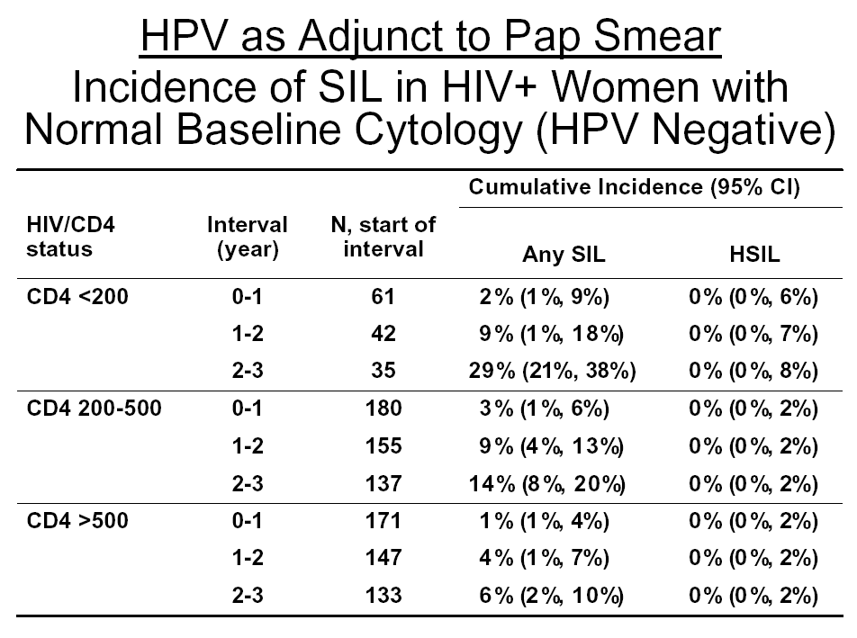
Harris et al, JAMA, 293: 1471-6, 2005

Slide 40
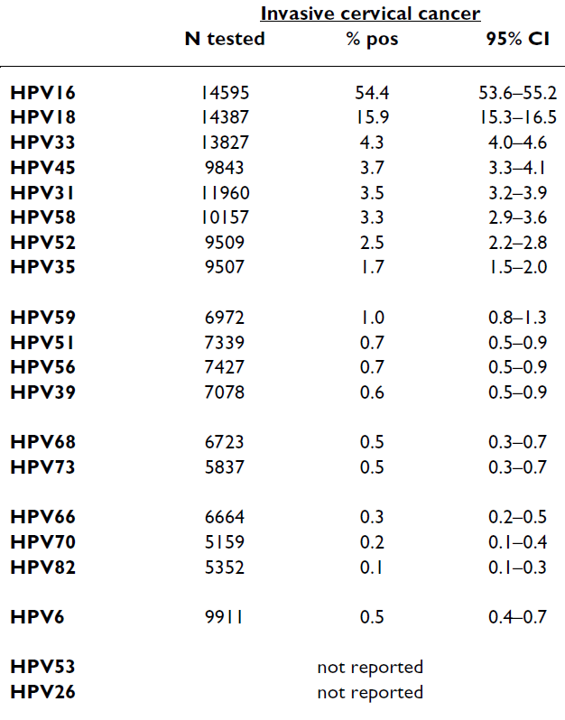
HPV Type Prevalence in Invasive Cervical Cancer (Schiffman, 2009)

Slide 41
HPV type-specific infection & CD4+ T-cell count in WIHS & HERS
Strickler et al, J Natl Cancer Inst 95: 1062-71, 2003

Slide 42
Prognosis of HPV-16 prevalent infections

Slide 43
Adherent & Effective HAART
Minkoff et al, JID, 2010

Slide 44
Completeness of Follow-up and Censoring
HSIL+ Analysis. Loss to follow-up averaged 3.6% per year in HIV(+) and 3.1% in HIV(-) women. Overall, follow-up at 5 years was 70% HIV(-) and 67% HIV(+). At 3 years it was 86% and 81%, respectively.
CIN-2+ Analysis. Loss to follow-up averaged 2.9 % per year in HlV(+) and 2.9% in HIV(-) women. Overall, follow-up at 5 years was 83% in HIV(-) and 78% in HIV(+). At 3 years it was 92% and 88%, respectively.

Slide 45
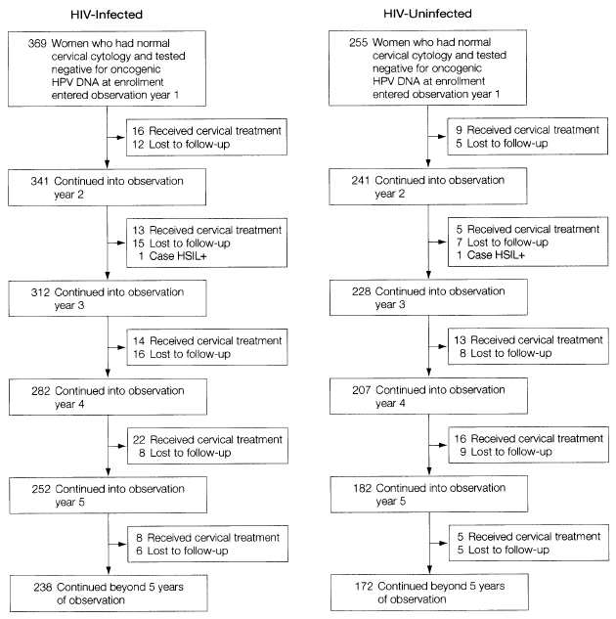
Loss to Follow-up and Censoring

Slide 46
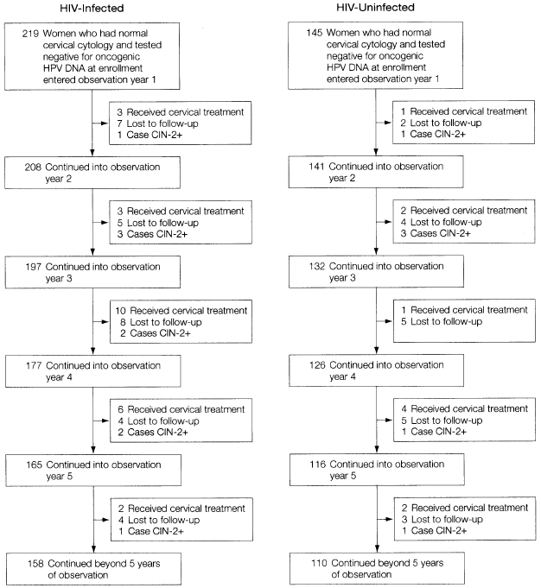

Slide 47
Risk among HPV-positives
CIN-2+ (HR = 5.6; 1.6-20; P=.007)

Slide 48
HIV/AIDS
JAMA Theme Issue Media Briefing
2012 International AIDS Conference
Sunday, July 22, 2012

Slide 49
Antiretroviral Treatment of Adult HIV Infection:
2012 Recommendations of the
International Antiviral Society−USA Panel
Melanie A. Thompson, MD; Judith A. Aberg, MD; Jennifer F. Hoy, MBBS, FRACP; Amalio Telenti, MD, PhD; Constance Benson, MD; Pedro Cahn, MD, PhD; Joseph J. Eron Jr, MD; Huldrych F. Günthard, MD; Scott M. Hammer, MD; Peter Reiss, MD, PhD; Douglas D. Richman, MD; Giuliano Rizzardini, MD; David L. Thomas, MD; Donna M. Jacobsen, BS; Paul A. Volberding, MD
Thompson et al, JAMA, 2012.
The International Antiviral Society–USA

Slide 50
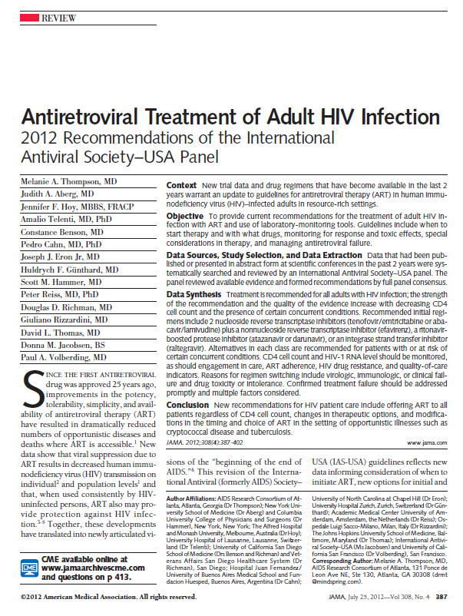
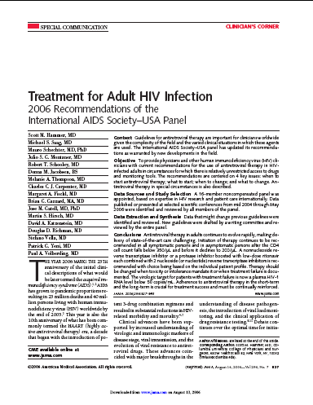
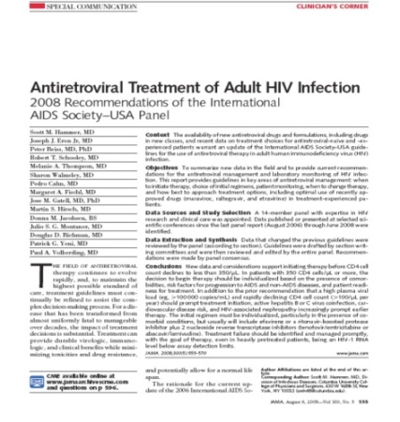
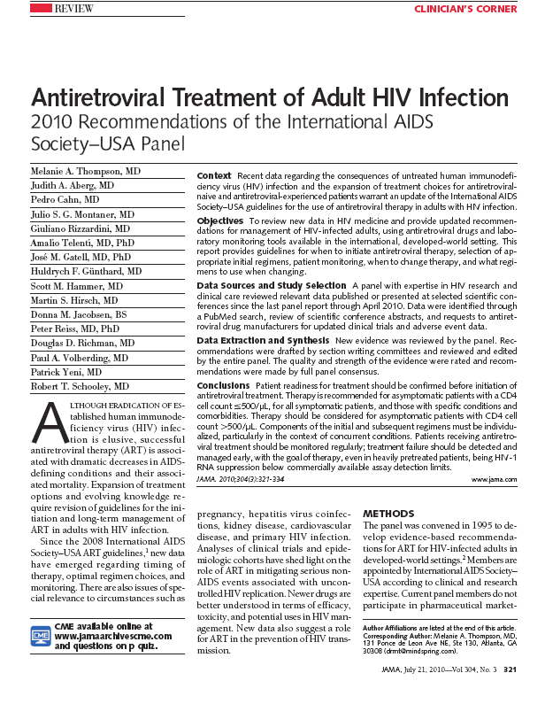
IAS−USA
Antiretroviral Guidelines
1996 – 2012

Slide 51
IAS−USA Antiretroviral Guidelines
Authored by 15-member, international (6 countries) panel
  Members receive no compensation and agree not to participate in industry promotional activities while on the panel
Evidence-based guidelines are developed by consensus and based upon pathogenesis research, well-designed clinical trials, and large observational cohorts
Rated on strength of recommendations and quality of evidence
Primarily for clinicians in highly resourced settings; however, principles are universally applicable
Thompson et al, JAMA, 2012.

Slide 52
Methods
Systematic literature review of PubMed and EMBASE for data published or presented 7/10 – 5/12
Hand searches for newly published reports and scientific abstracts, safety reports
Product efficacy or safety data from ARV manufacturers were reviewed to assure completeness
Data not published or presented in a peer-reviewed setting were not considered, except safety reports
Thompson et al, JAMA, 2012.

Slide 53
When to Start
Antiretroviral Therapy

Slide 54
Antiretroviral therapy (ART) is recommended and should be offered to all persons with HIV regardless of CD4 cell count.

Slide 55
Potential Risks and Benefits of Earlier ART Initiation
Potential Benefits
Prevention of progressive immune destruction (AIDS) and improved survival
Decreased immune activation, inflammation, and serious non-AIDS diseases
Decreased drug resistance
Decreased risk for some ARV toxicities
Decreased HIV transmission
Potential Risks
ARV toxicity – short and long term
If adherence is suboptimal, risk of resistance and transmission of resistant virus
Resistance may limit future choices of ART

Slide 56
Rationale for Recommending ART for
All HIV-Infected Adults
  Uncontrolled HIV replication, immune activation and inflammation associated with serious ‘non-AIDS’ illnesses even at CD4 counts > 500/µL
    Cardiovascular, hepatic, renal, neurologic, malignancies
    High CD4 counts and suppressed virus are associated with decreased disease incidence
  Newer therapies are more potent, less toxic, more tolerable, and simpler to take leading to improved patient adherence and regimen durability
  ART decreases HIV transmission
Thompson et al, JAMA, 2012.
Notes:
Malignancies The ANRS C04
ATHENA dec nonADD
AIDS or death COHERE, CAUSAL
Centers for AIDS Research Network of Integrated Clinical Systems (CNICS) cohort found that total
cumulative exposure to replicating virus over time is independently associated with mortality. Using viremia
copy-years, the HR for mortality was 1.81 per log 10 copy-year/mL

Slide 57
Earlier ART Associated with Decreased Mortality and Disease Progression: Observational Studies
Study | Published | N | Endpoint | Relative Hazard | P or 95% CI
NA-ACCORD | NEJM, 2009 | 8,362 | Death | 1.69 CD4 <350 vs 350-500 | < 0.001
NA-ACCORD | NEJM, 2009 | 9,155 | Death | 1.94 CD4 <500 vs > 500 | < 0.001
When to Start Consortium | Lancet, 2009 | 24,444 | AIDS or Death | 1.28 CD4 251-350 vs 351-400 | 1.04–1.57
HIV-CAUSAL | Ann Int Med, 2011 | 20,971 | AIDS or Death | 1.38 CD4 <350 vs <500 | 1.23-1.56
CASCADE | Arch Int Med, 2011 | 9,455 | Death | 0.51 (HR)* CD4 350-499 vs deferred | 0.33-0.80
COHERE | Plos Med, 2012 | 75,336 | AIDS or Death | 0.74 (HR)* CD4 350-<500 on ART 0.96 (HR)* CD4 > 500 on ART | 0.58-0.80 0.92-0.99
ATHENA | AIDS, 2012 | 3,068 | Death, AIDS, Non-AIDS | 1.54 CD4<200 vs <500 | 0.33-0.87

Slide 58
HPTN 052: ART Treatment
Reduces HIV-1 Transmission
Total HIV-1 Transmission Events: 39
Immediate Arm
4
Delayed Arm
35
96% Reduction with Early ART
Cohen, NEJM 2011;
365:492-505
p < 0.0001
Notes:
We screened 10, 838 infected people to enroll 1763 couples. Note that the couples were equally distributed in groups. 50% of the infected participants were men (WE NEED TO DELETE SOME DETAIL!!)

Slide 59
When to Start ART: IAS–USA Recommendations 2012
Patient readiness should be considered when deciding to initiate ART
ART is recommended and should be offered regardless of CD4 cell count
The strength of the recommendation and quality of the evidence increases as CD4 count decreases and in the presence of certain conditions

Slide 60
When to Start ART: IAS–USA Recommendations 2012
Strength of recommendation and quality of evidence varies
  According to CD4 cell count
    CD4 < 500 cells/µL (AIa)
    CD4 > 500 cells/µL (BIII)
  According to clinical condition
    Pregnancy (AIa)
    Chronic HBV (AIIa)
    HCV (may delay until after HCV treatment if CD4 > 500) (CIII)
    Age older than 60 years (BIIa)
    HIV-associated nephropathy (AIIa)
    Acute phase of primary HIV infection, regardless of symptoms (BIII)

Slide 61
Initiation of Antiretroviral Therapy in HIV-Infected Adults
Criteria | IAS-USA 2012 | DHHS 2012 | EACS 2011 | WHO 2010
CD4 count <350/µL | Treat | Treat | Treat | Treat
CD4 count 350-500/µL |  |  | Asymptomatic: Consider Symptomatic: Treat | Stage 3 or 4
CD4 count > 500/µL |  |  | Symptomatic: Treat | Stage 3 or 4
Pregnancy | Treat | Treat | Treat | < 350/µL;Stage 3-4
History AIDS-defining Illness | Treat | Treat | Treat | Treat
HIV-assoc Nephropathy | Treat | Treat | Treat | Not specified
HBC Coinfection | Treat | Treat | Treat, if HBV tx indicated | Treat, if HBV tx indicated
HCV Coinfection | Treat; Consider treating HCV first if CD4 > 500/µL | Treat; Consider treating HCV first if CD4 > 500/µL | Treat if CD4< 500/µL; Defer /consider CD4 >500/µL | Not specified
Age > 60 years | Treat | Not specified | Not specified | Not specified

Slide 62
Other Important New Recommendations
Early ART initiation when opportunistic infections are present, except cryptococcal meningitis and TB meningitis, where expert consultation is required
When and how to use existing, new, and emerging therapies
Monitoring for entry into and retention in care, ART adherence, and quality indicators
Consideration of PrEP

Slide 63
Path to an
“AIDS-free Generation”

Slide 64
Early diagnosis through increased testing
Prevention education, condoms, and consideration of PrEP for high-risk HIV uninfected individuals
Monitor and enhance entry into care and retention in care
Universal access to ART, for individual and societal benefit
Monitor and support ART adherence
Continued efforts at the highest levels to decrease social determinants of health, including stigma
Continued research on new strategies for treatment, prevention, and cure
Activism to encourage the political will to fully fund evidence-based prevention and treatment interventions

Slide 65
Backup Slides

Slide 66
Choice of Initial Regimen
  Tenofovir/emtricitabine (TDF/FTC) OR
  Abacavir/lamivudine (ABC/3TC)
  WITH
  Third agent (NNRTI, boosted PI, or InSTI):
    Efavirenz OR
    Atazanavir/r OR
    Darunavir/r OR
    Raltegravir
HLA B*5701 negative
HIV-1 RNA <100,000 c/mL
Thompson et al, JAMA, 2012.

Slide 67
Alternative Initial Antiretroviral Regimens*
Component | Alternative Regimens
NNRTI plus nRTIs | Nevirapine plus tenofovir/emtricitabine or abacavir/lamivudine (BIa) Rilpivirine/tenofovir/emtricitabine (or rilpivirine plus abacavir/lamivudine) (BIa)
 | Comment Severe hepatotoxicity and rash with nevirapine more common in initial therapy when CD4 cell count is >250/µL in women and >400/µL in men
Thompson et al, JAMA, 2012.

Slide 68
Alternative Initial Antiretroviral Regimens*
Component | Alternative Regimens
PI/r plus nRTIs | Darunavir/r plus abacavir/lamivudine (BIII) Lopinavir/r plus tenofovir/emtricitabine (BIa) (or abacavir/lamivudine) (BIa)
 | Comment Other alternative PIs include fosamprenavir/r and saquinavir/r but indications to use these options for initial treatment are rare.
Thompson et al, JAMA, 2012.

Slide 69
Alternative Initial Antiretroviral Regimens*
Component | Alternative Regimens
InSTI plus nRTIs | Raltegravir plus abacavir/lamivudine (BIIa) Elvitegravir/cobicistat/tenofovir/emtricitabine** (BIb) Comment Raltegravir is given twice daily; experience with elvitegravir/cobicistat/tenofovir/emtricitabine is limited to 48-week data.
* Submitted for regulatory approval
Thompson et al, JAMA, 2012.

Slide 70
CCR5 Antagonist−Based and nRTI-Sparing Initial Regimens in Special Circumstances Only
Component | Regimens
CCR5 antagonist plus nRTIs, (NNRTI-, PI-, and InSTI-sparing) PI/r plus InSTI (nRTI-sparing) | Maraviroc plus tenofovir/emtricitabine or abacavir/lamivudine (CIII) Darunavir/r plus raltegravir (BIIa) Lopinavir/r plus raltegravir (BIa)
* See comments
Thompson et al, JAMA, 2012.

Slide 71
HIV/AIDS
JAMA Theme Issue Media Briefing
2012 International AIDS Conference
Sunday, July 22, 2012

